Slide 1


EE202C IoT Smart Drone
UCLA
Peidong Chen, Yitian Hu, Yang Yang, Jiayu Guo
Advisor: Prof. William Kaiser

Slide 2

The IOT functions:
GPS navigation and object tracking by image processing
Amazon delivery
Fugitive detecting and tracking

Slide 3
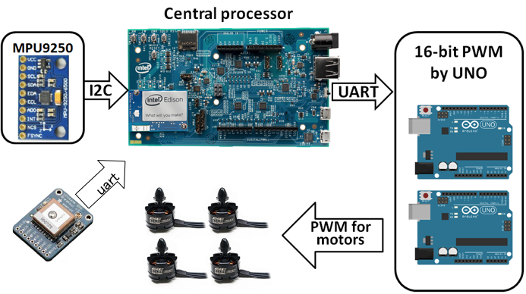
System Architecture (Before)

Slide 4
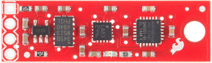
System Architecture (Before)

Slide 5

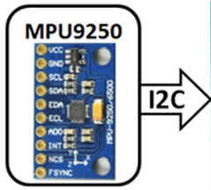
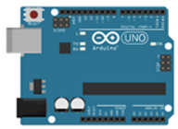

System Architecture (Before)

Slide 6
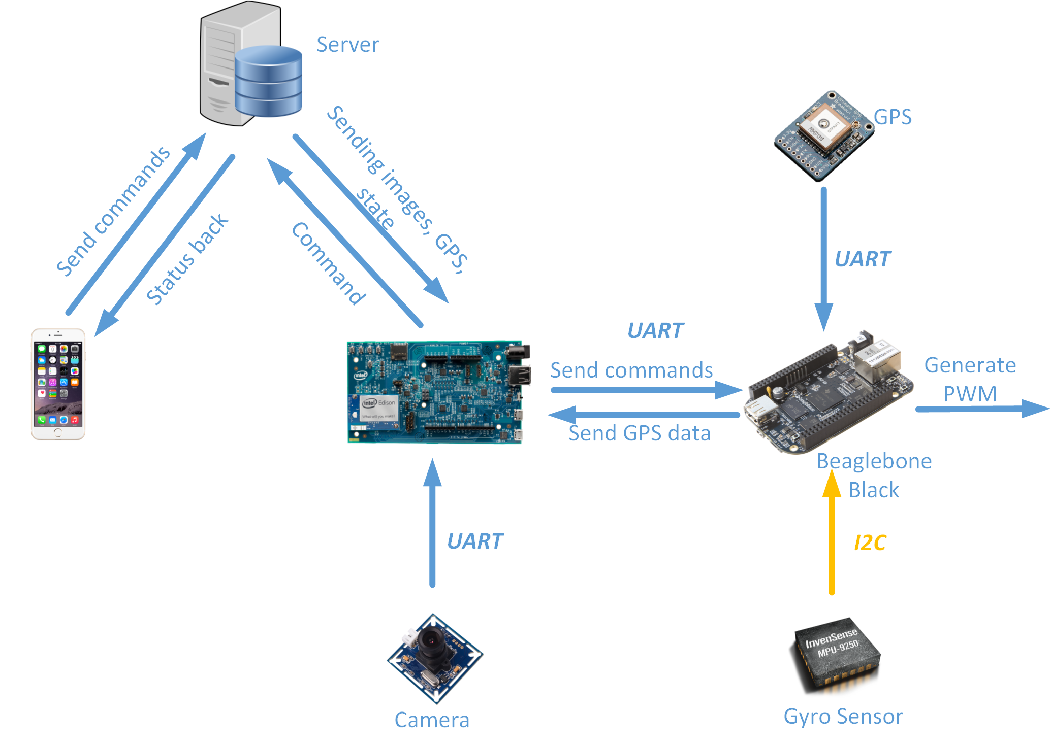
System Architecture (Now)

Slide 7
Edison Software Flowchart
Process 1
(C code)
Start
Thread 1:
Http get commands, send to BBB
Thread 2:
Http get pid parameters
Thread 3:
Receive messages from beaglebone
Thread 4:
Http post data to server
Thread 5:
GPS Navigation

Slide 8
Edison Software Flowchart
Process 2
(Python)
Start
Thread 1:
Http get image detection and GPS info
Thread 2:
Http post images to server
Thread 3:
Send commands to beaglebone

Slide 9
Beaglebone Black ( Flight controller )
Start
Thread 1:
Generate 16-bit PWM
Thread 2:
Read gyro
Thread 3:
Receive messages from Edison
Thread 4:
PID feedback
Thread 5:
Read GPS and send it to Edison

Slide 10
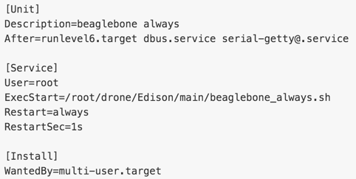
Beaglebone Black
Since there is no Internet access for Beaglebone,it should start the flight controller functions when it boots.

Slide 11
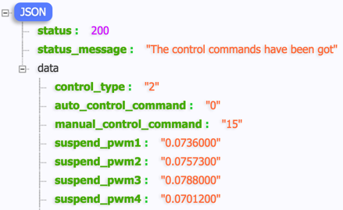
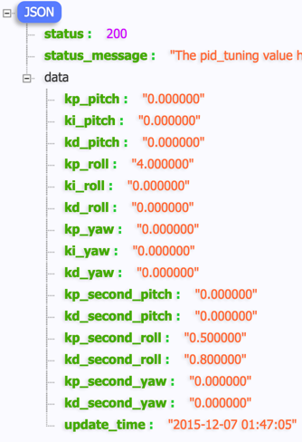
Server REST API
Written in PHP
Commands
GET api/control
POST api/control
PID tuning
GET api/pid_tuning
POST api/pid_tuning
GPS
GET api/gps
POST api/gps
Camera
GET api/camera
POST api/camera

Slide 12
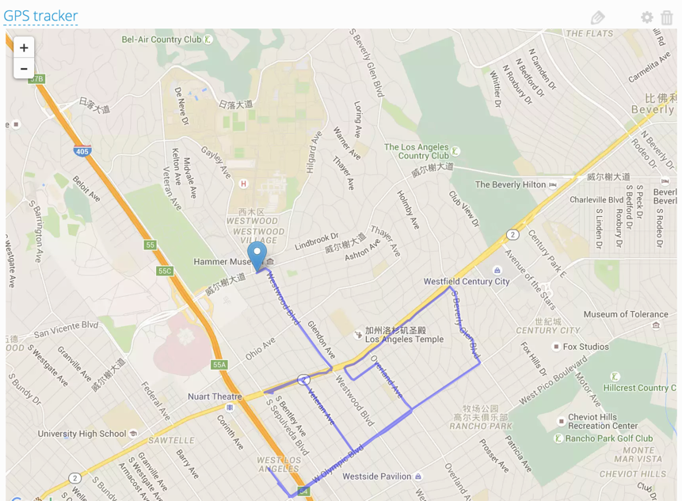
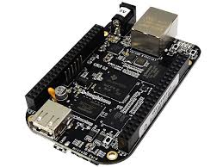
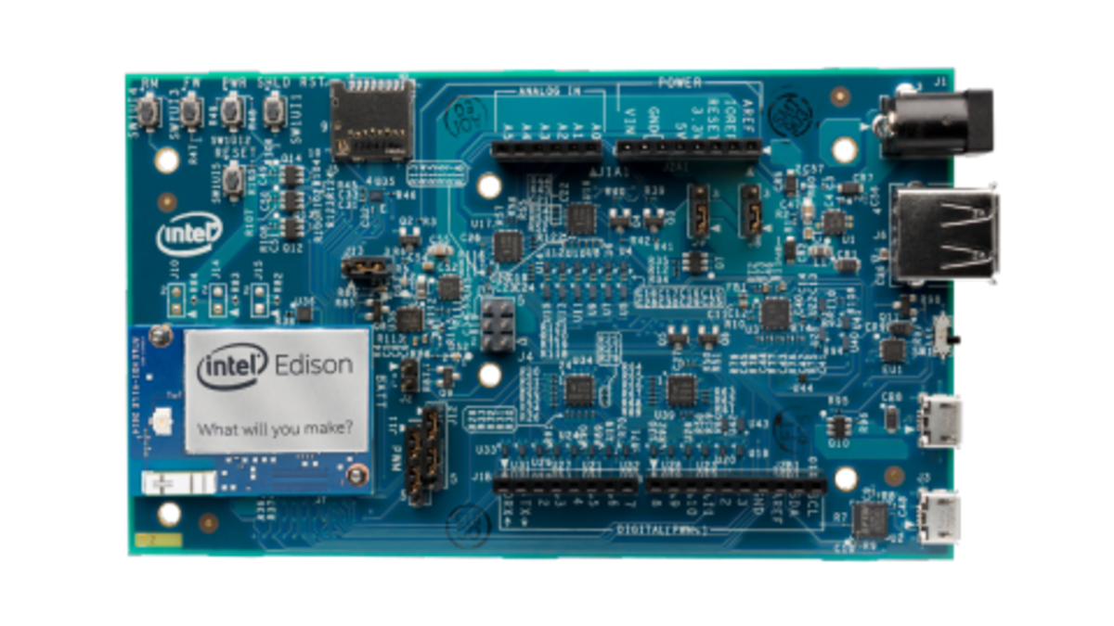
GPS Location Tracker
Ubidots:
Server
Server
Send info to GPS tracking server
HTTP
UART
UART
GPS
"GPRMC"format

Slide 13
GPS Tracker Demo
https://www.youtube.com/watch?v=biHrlLmg0Tg

Slide 14
Flight Position Control
Auto_flight()
Manual_flight()
Stop_flight()
Flight Mode Control
Set yaw,pitch, raw value
Motor Output

Slide 15
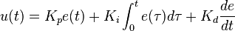
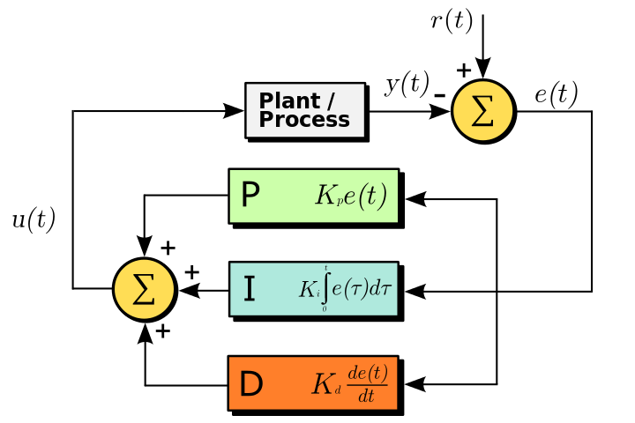
Series PID Design&Tuning
Yaw Pitch Roll PID controller
Angular velocity PID controller
ESC propeller module
Angular input reference
Gyro:Ω​​​
Θ
9 Dof sensor
filter
1/s
Non-symmetric/large signal
MARG
filter
Higher sampling rate
One Loop Angle PID controller
{Imperfection:
integral wind-up
Real world derivative noise
Code generated decay&spike}
Outer Loop Angle PID & Inner Loop Angular velocity PID controller

Slide 16
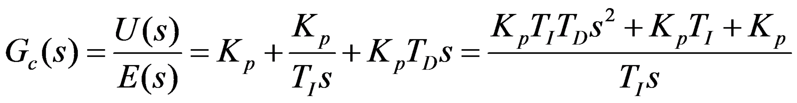
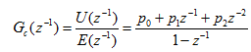
Series PID
pidData->output= pidData->prevOutput+
pidData->zKp*pidData->error+ pidData->iTerm+pidData- >dTerm;
PIDsetsetpoint();
PIDsettunings();
PIDRun();
Noise Filter&Calibration
1.Kalman filter
2.MARG (mag/gyro)
3.Simple round process
< 0.6 ◦ RMS error;

Slide 17
PID tuning Demo
https://www.youtube.com/watch?v=M6bZd2e6u7M

Slide 18
Detection and Follow
Get reference image
Send GPS information
Reference image
Detector
Lost object
Object location
Movement Command
Follower

Slide 19
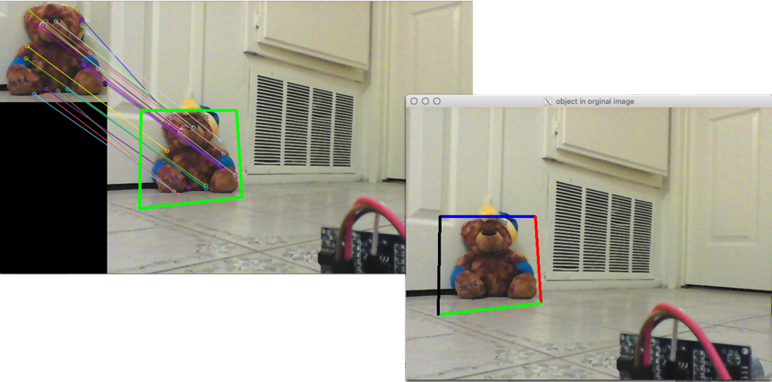
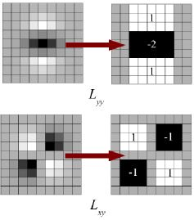
Detector
Surf Algorithm:
Receive reference image from server
Find object according specific features
Send location information to tracker

Slide 20

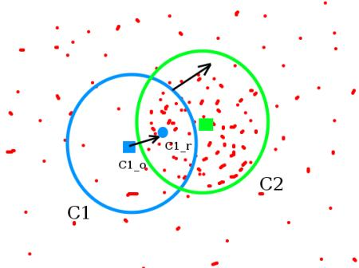
Tracker
Camshift Algorithm:
From initial location get the target distribution
Do histogram backproject to generate the probability image
Weight and ratio the histogram
Iterate Mean shift to find the centroid location and reccord 0th moment
Update location
Update the window size using 0th moment

Slide 21
Detection Demo
https://www.youtube.com/watch?v=s-hM2iVRJzo

Slide 22
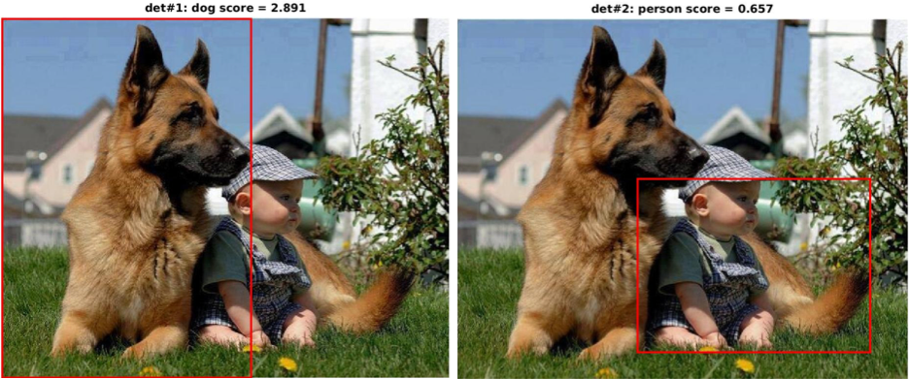
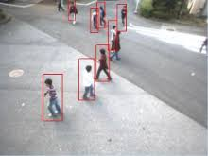
Accuracy detection algorithm
Deep learning algorithm: fast rcnn
HOG + SVM for human detection

Slide 23

Searching
Keep sending pictures and GPS
Send command to all near by drone
Detection nearby using GPS
Images
Accuracy detection algorithm
Detection and following model
Save reference image
Send reference image

Slide 24
Problems and Future Work
Problems
Reading GPS data and sending commands via the only one UART can randomly cause Edison to reboot.
Future work
Integrate GPS navigation, detection and tracking functions to drone when it can fly
Finish the fly video in around one week

Slide 25

Thank you

